Slide 1
Career Counseling Presentation: Vincent’s Career Path Out of the Closet and Into the Light
John Nolan
Grand Canyon University
College of Humanities and Social Sciences
Career Counseling
CNL-525-O501
Dr. Laurie Tone
1/31/2024

Slide 2


Welcome Everyone!
Notes:
Welcome everyone! Today we will discuss the case study of Vincent Arroyo: “Casket, Closets, and Careers” and explore ways to help counsel our fictional client Vincent in his future career path.

Slide 3

Client Demographics
  Name: Vincent Arroyo
  Age: 17
  Sex: Male
  Race/Ethnicity: Hispanic
  Education: High School Junior
Notes:
As we begin our exploration of Vincent's career development needs, it's important to recognize the impact of his demographic background. At 17, Vincent stands at a critical juncture, facing decisions that will shape his adult life. His male gender, within the context of societal norms, may influence his perception of career roles and opportunities. Considering Vincent's Hispanic ethnicity, we must be aware of the cultural values and family expectations that could shape his career decisions. His current educational level, being a high school junior, also plays a crucial role. We know from Kail & Cavanaugh (2019) that adolescent development involves identity formation, which is crucial in career decision-making. Thus, understanding these demographic factors is key in providing culturally sensitive and developmentally appropriate career counseling.

Slide 4
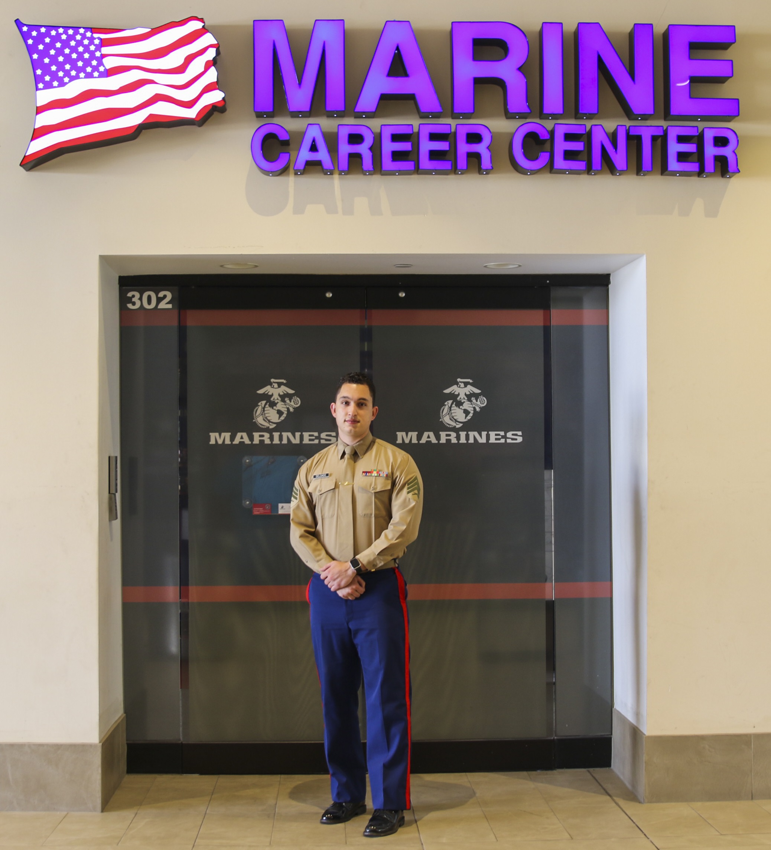
Current Career Development
  Current Employment: Works at a bodega after school
  Academic Performance: Cs and Ds in high school
  Aspirations: Interested in joining the military
Notes:
Vincent's current employment at a bodega demonstrates a strong sense of responsibility and work ethic. However, balancing work with school has impacted his academic performance. This situation highlights the need for career counseling that addresses time management and academic support, as suggested by the ACA Code of Ethics, which emphasizes a holistic approach to counseling. Vincent's aspiration to join the military is particularly significant. As noted by the National Board for Certified Counselors (2022), military careers can be appealing due to their structure, discipline, and sense of purpose. However, understanding Vincent’s motivations – whether they stem from a desire to honor his father, a search for identity, or societal influences – is essential. This aligns with Holland's RIASEC model, where personal inclinations and environmental factors interplay in career choices.

Slide 5
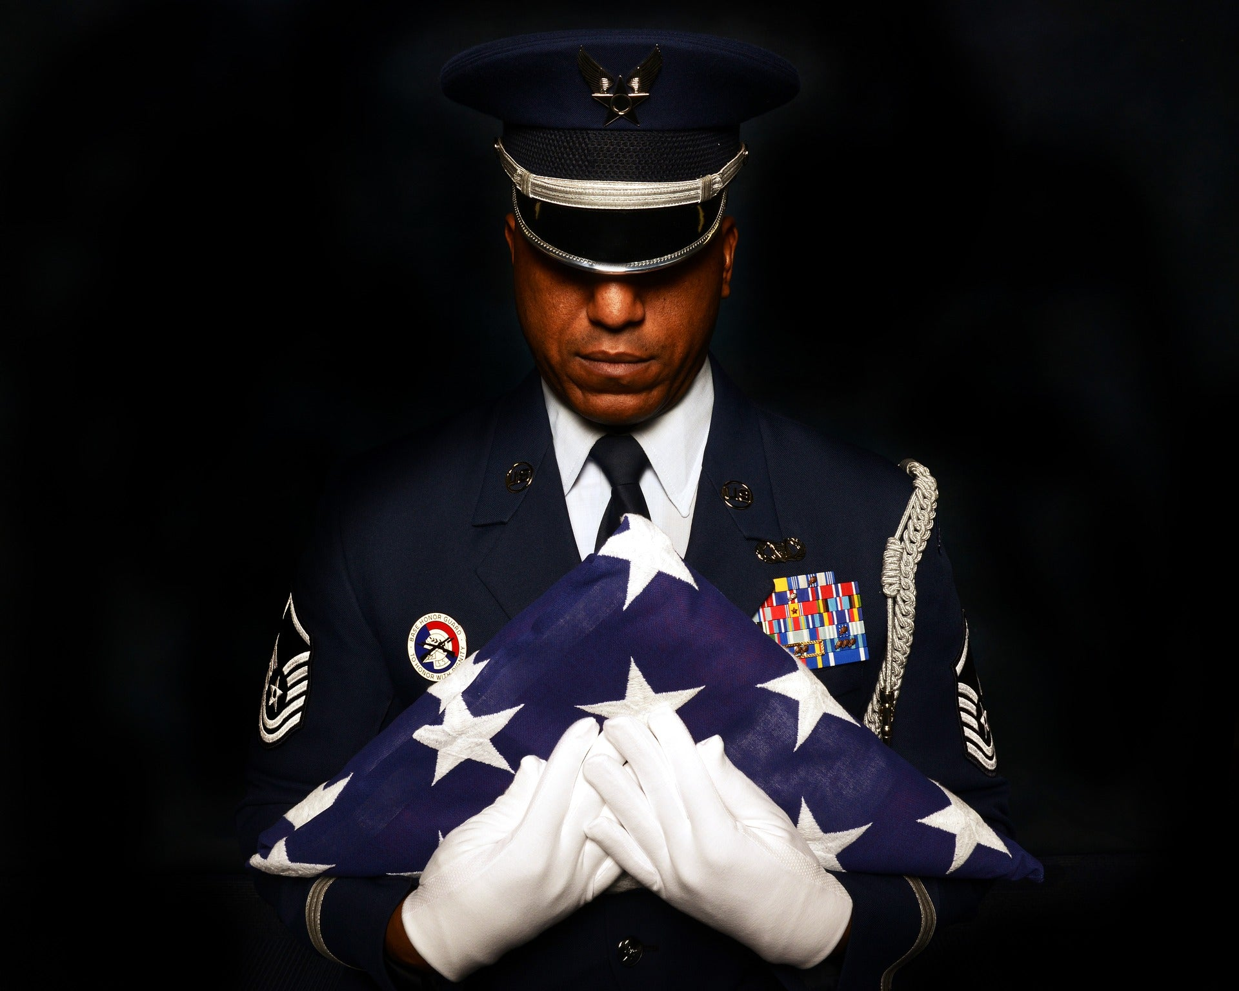
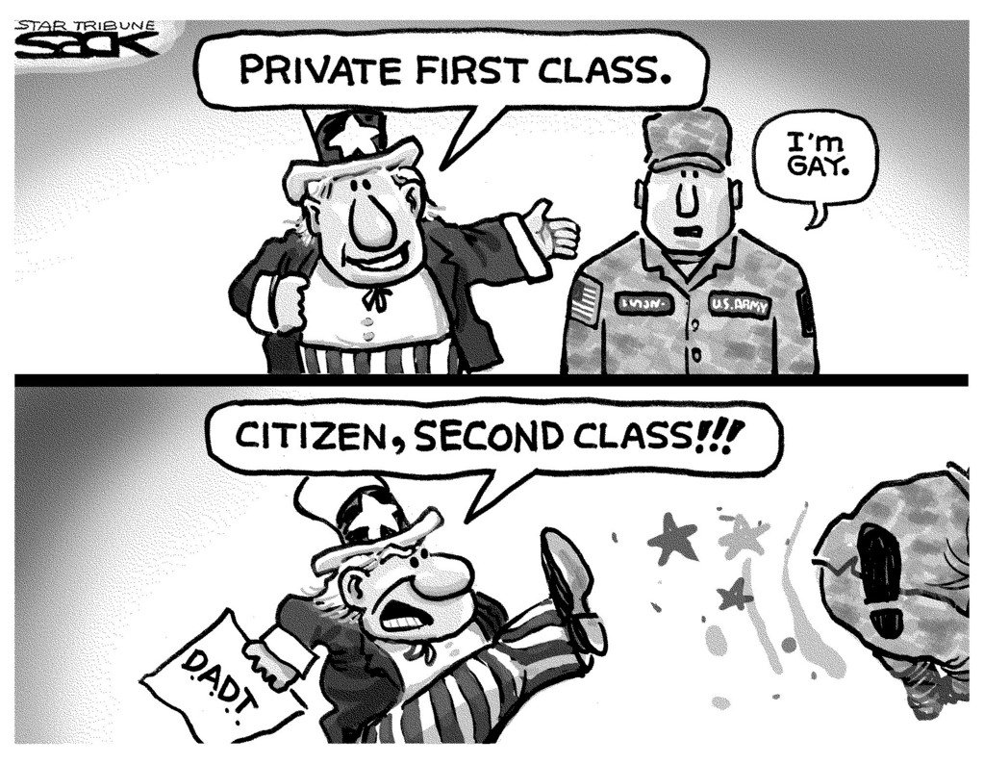

Reasons for Seeking Career Counseling
Notes:
Vincent’s motivation for seeking career counseling is deeply intertwined with his personal history and identity. His desire to honor his father's legacy by joining the military is a powerful driver but comes with internal conflicts. According to Corey et al. (2015), understanding a client's personal values and conflicts is crucial in ethical counseling. Vincent's uncertainty regarding his career suitability, given his sexual orientation, adds another layer of complexity. The repeal of the 'don't ask, don't tell' policy in the military context is a positive step, yet concerns about acceptance and belonging remain pertinent. This situation highlights the importance of providing a safe, nonjudgmental space for Vincent to explore his career options, aligning with the ethical guidelines provided by the American Counseling Association (2014).

Slide 6
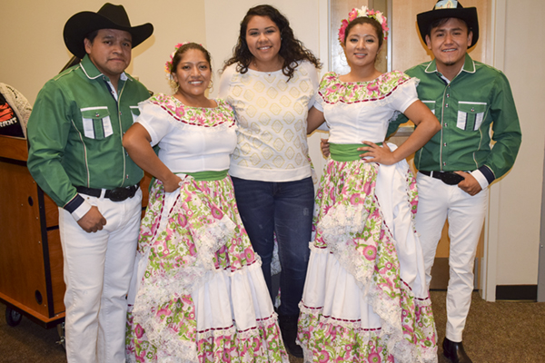


Unique Challenges and Cultural Considerations
Notes:
Vincent's career counseling needs must be addressed in the context of his unique challenges. His economic strain, due to contributing to family finances, may limit his access to certain educational and career opportunities, necessitating a focus on accessible pathways. His sexual orientation, particularly in the context of his aspiration to join the military, presents a challenge in an environment that has historically been less accepting. It's crucial to explore how this aspect of his identity intersects with his career choices, as per the NCDA Code of Ethics’ emphasis on respect for diversity. Additionally, Vincent's Hispanic background may influence his career decisions, where familial expectations and cultural values play a significant role. Understanding these elements is key in providing culturally competent counseling, as recommended by Brown & Lent (2021), ensuring that career advice is relevant and respects his cultural identity.

Slide 7
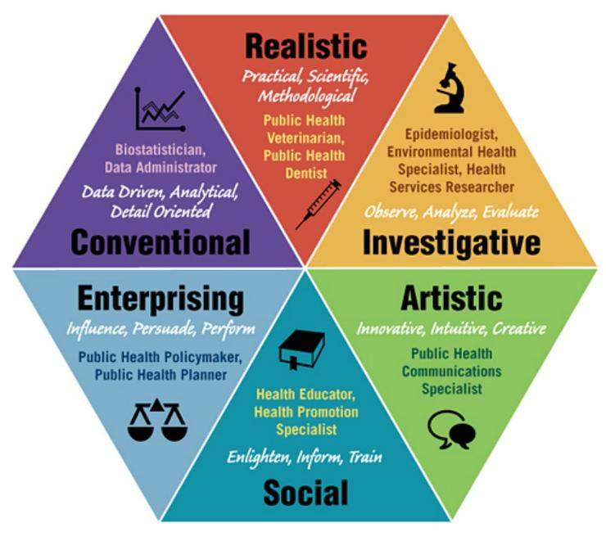
Holland's RIASEC Model Overview
Notes:
Holland's RIASEC Model is instrumental in understanding Vincent's career choices. This model categorizes personalities into six types - Realistic, Investigative, Artistic, Social, Enterprising, and Conventional. Each type prefers certain work environments and activities, and the match between a person's type and their work environment is crucial for career satisfaction. For instance, a 'Social' type thrives in helping roles like teaching or counseling, as they value human interaction and service. Understanding Vincent's personality type will help us identify suitable career paths and environments. According to Brown and Lent (2021), a strong person-environment fit leads to greater job satisfaction and success. This model will aid in assessing which environments allow Vincent to utilize his abilities, express his attitudes and values, and meet his need for fulfillment.

Slide 8
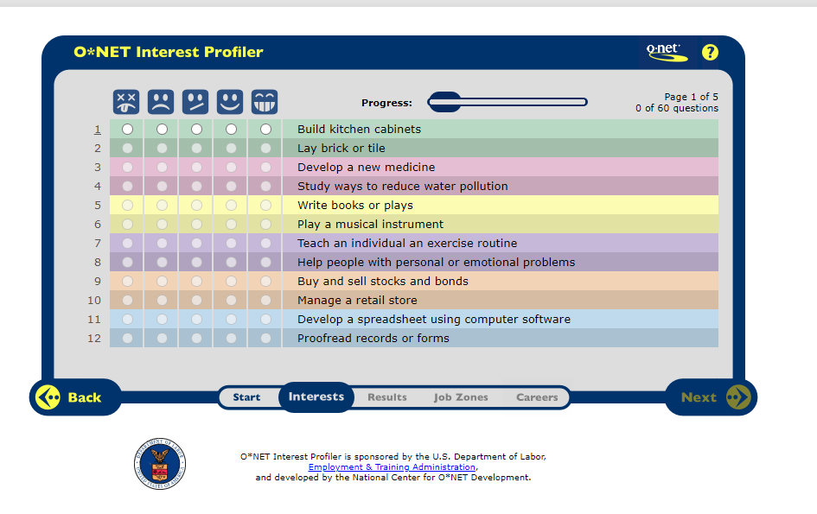
Application of Holland's RIASEC Model to Vincent's Case
Notes:
Applying Holland’s RIASEC Model to Vincent’s case involves a two-fold approach. First, we need to assess Vincent's dominant personality type or types. This assessment will consider his interests, values, and preferred activities, both inside and outside of school. Is he drawn to structured, rule-regulated activities, suggesting a 'Conventional' type? Or does he prefer roles involving leadership and persuasion, aligning with an 'Enterprising' type? Understanding this will guide us in exploring suitable career paths. Second, we'll explore vocational environments that match his personality type. If Vincent is 'Enterprising', for instance, we'll explore careers in business or politics. This approach is in line with the person-environment fit concept, where a good match can lead to greater career satisfaction and success. It’s important to remember, as per Kail & Cavanaugh (2019), that adolescent identity is still forming, so flexibility in career planning is crucial.

Slide 9


Initial Assessment Information
Notes:
For an effective initial assessment of Vincent, we need to gather comprehensive information. First, understanding his personal interests, including hobbies, subjects he enjoys in school, and activities he's drawn to, is crucial. These interests can provide insights into potential career paths and personality types as per Holland's model. Secondly, reviewing Vincent's academic and work history is essential. This includes not just grades but also subjects he excels in or struggles with, and his experiences and skills gained from working at the bodega. Lastly, identifying Vincent's personal challenges and strengths is vital. Challenges might include his economic situation, balancing work and school, and dealing with his sexual identity in a potentially unsupportive environment. Strengths could be his resilience, work ethic, and dedication to family. This holistic assessment aligns with the ACA Code of Ethics, emphasizing the importance of understanding the client's world from a multifaceted perspective.

Slide 10
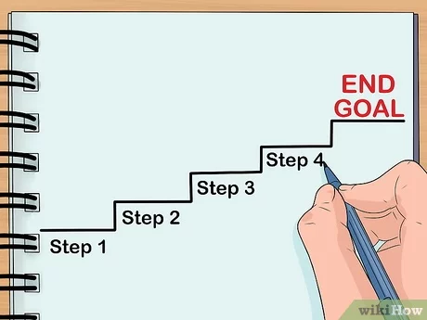
Steps in the Career Development Process
Notes:
The career development process we'll undertake with Vincent follows four key steps. The first step, Self-Assessment, involves helping Vincent to explore his interests, skills, values, and personality traits, aligning with Holland’s RIASEC model. Tools like the Self-Directed Search (SDS) can be instrumental here. The second step is Exploring Career Options, where we'll introduce Vincent to various career paths that align with his assessment results, including military options and alternatives. This exploration will be guided by his personality type, interests, and the realities of his current situation. Decision-Making, the third step, involves evaluating the pros and cons of each option and considering factors like job availability, educational requirements, and personal values. Finally, Action Planning is where we'll develop a concrete plan for Vincent to pursue his chosen career path, including steps like additional education, work experience, or skill development. This structured approach, as outlined by Brown and Lent (2021), ensures a comprehensive and client-centered career development process.

Slide 11
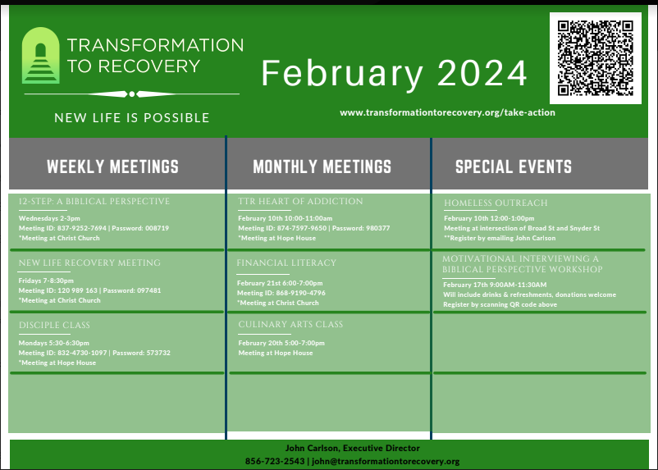
Career Resources
Online:
    O*NET Online, My Next Move: https://www.mynextmove.org/explore/ip
    Myers-Briggs Test: https://www.truity.com/test/type-finder-careers
Local to Vincent’s location in NYC:
    New York State Department of Labor, NYC Career Centers: 90-02 Queens Blvd, Queens, NY 11373, Phone: (718) 321-6307
    Identity House: https://identityhouse.org/walk-in-center/, 208 W 13th St, New York, NY 10011, Phone: (212)-620-7310
Notes:
To aid Vincent in his career exploration and decision-making process, we have several valuable resources. Online, O*NET Online and My Next Move offer extensive databases and tools for occupational exploration. These platforms provide detailed information on various careers, including required skills, education, and potential career paths. This can help Vincent explore and evaluate different options that align with his interests and skills. Additionally, the Myers-Briggs Test available at Truity is a useful tool for understanding personality types and how they relate to career preferences. This insight can assist Vincent in identifying careers that suit his personality traits and work style.
Locally, the New York State Department of Labor and NYC Career Centers located at Queens Blvd provide personalized counseling services, workshops, and job placement assistance. These services can offer Vincent practical support in navigating the job market and accessing training opportunities. Furthermore, Identity House, located in New York, NY, offers support specifically tailored for LGBTQ+ individuals. This resource could be particularly valuable for Vincent as he navigates his career choices in the context of his personal identity. Here, he can find a safe space for exploration and support, addressing not just career-related questions but also personal challenges and concerns. I’ve also included a local resource to the Philadelphia area, Transformation to Recovery, a Christian based support group that dabbles in all kinds of support ranging from career guidance, spiritual guidance, financial literacy, etc. Utilizing these resources will enable Vincent to make informed decisions about his career path, taking into account his unique personal and contextual factors.

Slide 12
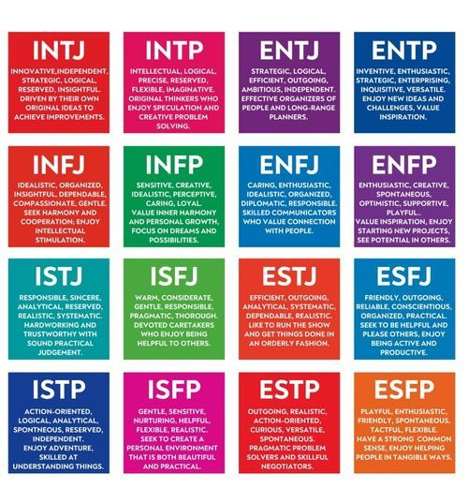
Career Assessment Tools
Notes:
To facilitate Vincent's career development process, we would use two key assessment tools. The Self-Directed Search (SDS) is a tool based on Holland's RIASEC model, which will help Vincent identify his personality type and suggest careers that are a good fit. This tool aligns with our theoretical framework and provides a structured approach to exploring career options. The Myers-Briggs Type Indicator (MBTI) is another excellent tool for understanding Vincent's personality preferences, which can influence his career choices. The MBTI will provide insights into how Vincent perceives the world and makes decisions, crucial factors in career planning. According to Corey et al. (2015), using such assessment tools helps in making informed and ethical career counseling decisions. The results from these assessments will offer valuable insights for both Vincent and us as counselors, guiding the career exploration and decision-making process.

Slide 13



Ethical Principles and NCDA Standards
Notes:
In guiding Vincent through his career development process, adherence to ethical principles is paramount. Confidentiality is a key ethical principle in counseling, as outlined by the American Counseling Association (2014). It is crucial that Vincent feels his personal information, especially concerning his sexual orientation, is safe and secure with us. This assurance of privacy is vital in building trust and supporting open, honest communication. Additionally, the National Career Development Association (NCDA) emphasizes the importance of respecting diversity. This standard reminds us to be sensitive to and affirming of Vincent’s cultural background and sexual identity, ensuring our counseling practices are inclusive and equitable. Furthermore, informed consent is a critical standard. Vincent must be fully informed about the counseling process, the use of any assessment tools, and potential referrals. This ensures that he is an active participant in his career development journey, making choices that are truly his own and based on a clear understanding of all aspects of the process.

Slide 14


Referrals Needed
Notes:
Considering Vincent's unique circumstances and needs, several referrals are recommended. Firstly, a referral to LGBTQ+ support services, such as Identity House, can provide Vincent with a supportive community and resources tailored to his personal identity challenges. This can be crucial in helping him navigate any concerns or conflicts related to his sexual orientation, especially in the context of his career choices. Secondly, given Vincent’s economic situation and his role in supporting his family, a referral for financial counseling is advisable. This could be facilitated through local resources like the New York State Department of Labor. Financial counseling can assist Vincent in understanding how to manage his finances, explore financial aid options for further education or training, and make informed decisions about his career path that consider his financial responsibilities. These referrals are aligned with holistic career counseling approaches, recognizing that career decisions are often influenced by a range of personal and contextual factors.

Slide 15
Summary and Key Takeaways
  Comprehensive understanding of client demographics and background.
  Application of Holland's RIASEC Model for career matching.
  Importance of addressing unique challenges and cultural considerations.
  Utilization of various career resources and assessment tools.
  Adherence to ethical principles and NCDA standards in counseling.
  Importance of referrals for additional support.
Notes:
Our approach to Vincent's career counseling has been comprehensive, taking into account his unique demographics, personal challenges, and cultural background. We've applied Holland's RIASEC Model to help identify careers that align with his personality and interests. This model serves as a guiding framework to explore and evaluate suitable career options for Vincent. We've also underscored the importance of addressing Vincent's specific challenges, including his economic situation and personal identity concerns, ensuring our counseling is sensitive to these factors. The selection of career resources and assessment tools, such as O*NET Online, the Myers-Briggs Test, and the Self-Directed Search, are aimed at facilitating Vincent's self-exploration and informed decision-making. Ethical considerations, particularly confidentiality, respect for diversity, and informed consent, have been central to our approach, aligning with the ACA Code of Ethics and NCDA standards. Finally, the identified referrals, including LGBTQ+ support services and financial counseling, are crucial in providing Vincent with comprehensive support that goes beyond career guidance alone. This holistic approach reflects our commitment to supporting Vincent in all aspects of his career development journey.

Slide 16
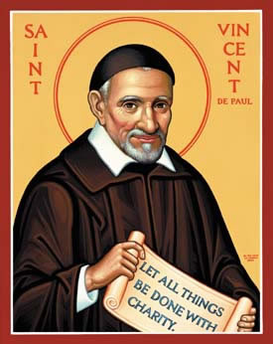

Conclusion and Next Steps
Notes:
As we conclude, I want to reaffirm our commitment to supporting Vincent in his journey towards a fulfilling career. The next steps involve ongoing counseling sessions where we will delve deeper into the assessment results, explore various career paths, and refine Vincent’s career goals. We will also work together on developing a realistic and actionable plan that considers both his immediate needs and long-term aspirations. It's important that Vincent feels empowered and actively involved in each step of this process. Our role is to guide, support, and provide the tools and resources he needs to make informed decisions. By working collaboratively, we aim to ensure that Vincent's career path is not only a reflection of his personal and professional aspirations but also a journey that respects and integrates all aspects of his identity and life circumstances.

Slide 17
References
American Counseling Association (2014). ACA Code of Ethics. Counseling.org.
Brown, S. D., & Lent, R. W. (Eds.).(2021). Career development and counseling: Putting theory and research to work (3rd ed.). John Wiley & Sons.
Corey, G., Corey, M. S., Corey, C., & Callanan, P. (2015). Issues and ethics in the helping professions
(9th ed.). Australia: Brooks/Cole.
Kail, R. V., & Cavanaugh, J. C. (2019). Human development: A life-span view (8th ed.). Cengage. ISBN-13: 9781337554831
National Board for Certified Counselors. (2022). Career Development Counseling for Military and Veteran Populations. Retrieved from https://www.nbcc.org.

